Slide 1
RANDOM FOREST
PRESENTED BY :
ANIL M A

Slide 2
CONTENTS
Introduction to Random forest algorithm
Classification and Regression Trees
Random forest algorithm terminology
Random forest algorithm intuition
Import libraries
Import dataset
Exploratory data analysis
Split data into separate training and test set
Confusion matrix
Results and conclusion
References

Slide 3
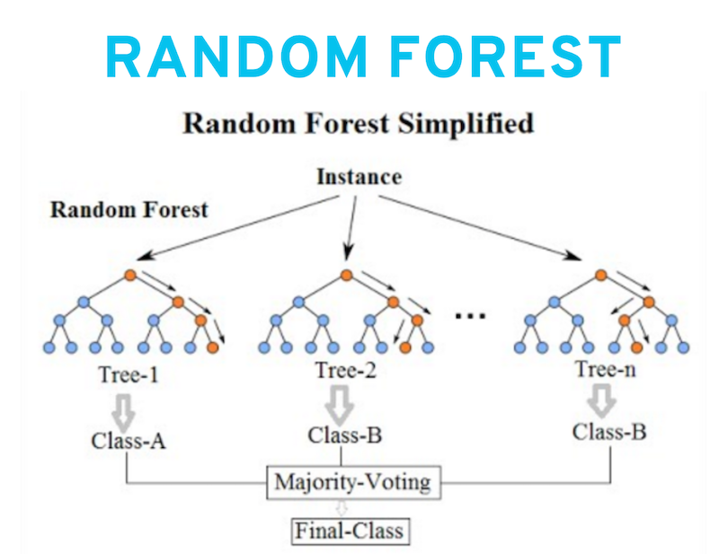
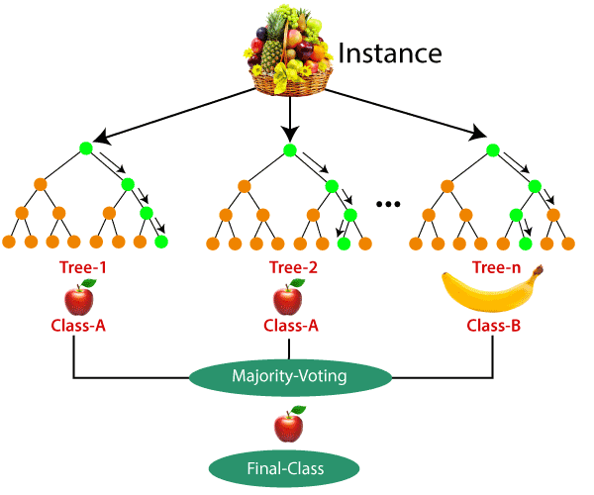
About Random forest
Random forest is a supervised learning algorithm. The "forest" it builds, is an ensemble of decision trees, usually trained with the “bagging” method. The general idea of the bagging method is that a combination of learning models increases the overall result

Slide 4
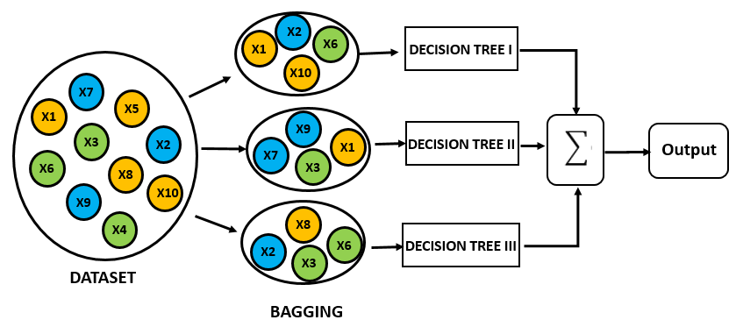
Random Forest algorithm terminology
1.Bagging
2.Random subspace method
3.Training estimators
4.Perform inference by aggregating predictions of estimators

Slide 5
Steps involved-
Import libraries and Datasets
Exploratory data analysis
Data Pre-processing step
Fitting the Random forest algorithm to the Training set
Predicting the test result
Test accuracy of the result (Creation of Confusion matrix)

Slide 6
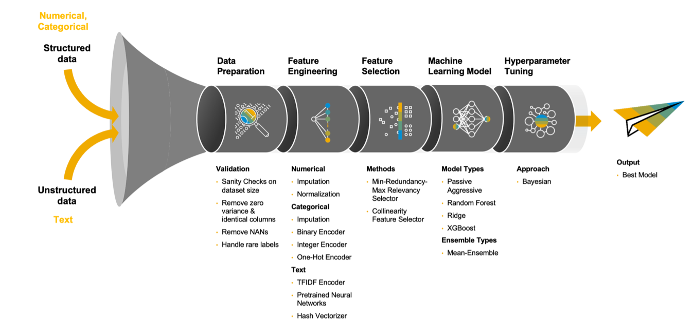

Slide 7
Random Forest algorithm intuition
Step 1: In Random forest n number of random records are taken from the data set having k number of records.
Step 2: Individual decision trees are constructed for each sample.
Step 3: Each decision tree will generate an output.
Step 4: Final output is considered based on Majority Voting or Averaging for Classification and regression respectively.

Slide 8
Random Forest Hyperparameters-
Important Hyperparameters
Following hyperparameters increases the predictive power:
1. n_estimators – number of trees the algorithm builds before averaging the predictions.
2. max_features – maximum number of features random forest considers splitting a node.
3. mini_sample_leaf – determines the minimum number of leaves required to split an internal node.
Following hyperparameters increases the speed:
1. n_jobs – it tells the engine how many processors it is allowed to use. If the value is 1, it can use only one processor but if the value is -1 there is no limit.
2. random_state – controls randomness of the sample. The model will always produce the same results if it has a definite value of random state and if it has been given the same hyperparameters and the same training data.
3. oob_score – OOB means out of the bag. It is a random forest cross-validation method. In this one-third of the sample is not used to train the data instead used to evaluate its performance. These samples are called out of bag samples.

Slide 9
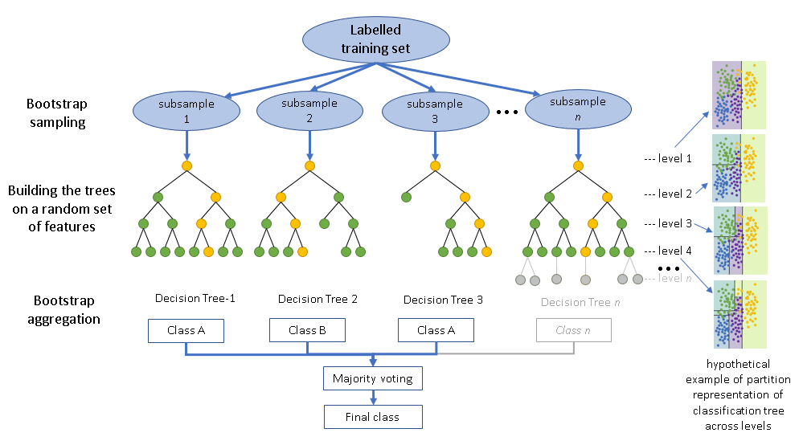
AN OVERVIEW OF WORKING OF THE MODEL

Slide 10
Advantages of Random Forest-
Random Forest is capable of performing both Classification and Regression tasks.
It is capable of handling large datasets with high dimensionality.
It enhances the accuracy of the model and prevents the overfitting issue.
Disadvantages of Random Forest-
Although random forest can be used for both classification and regression tasks, it is not more suitable for Regression tasks

Slide 11
Applications of Random Forest
There are mainly four sectors where Random forest mostly used:
Banking: Banking sector mostly uses this algorithm for the identification of loan risk.
Medicine: With the help of this algorithm, disease trends and risks of the disease can be identified.
Land Use: We can identify the areas of similar land use by this algorithm.
Marketing: Marketing trends can be identified using this algorithm.

Slide 12
CONCLUSION
In this project, I build a Random forest model to predict the Cancer type for future reference if a person has similar kind of disease. The model yields a very good performance as indicated by the model accuracy in the case which was found to be 0.95.
The confusion matrix and classification report yields very good model performance.

Slide 13
Reference
The work done in this project is inspired from following books and websites:-
Hands on Machine Learning with Scikit-Learn and Tensorflow by Aurélién Géron
Introduction to Machine Learning with Python by Andreas C. Müller and Sarah Guido
https://en.wikipedia.org/wiki/Random_forest
https://en.wikipedia.org/wiki/Entropy_(information_theory)
https://www.javatpoint.com/machine-learning-random-forest-algorithm

Slide 14
“Live as if you were to die tomorrow. Learn as if you were to live forever.” – Mahatma Gandhi

Slide 15
Thank you

